Slide 1

Project Presentation
Project
Under the guidance of
Professor SUJEET KUMAR
Department Electronics & Communication Engineering,
IMS Engineering College, Ghaziabad

Slide 2
Advance HOME AUTOMATION USING IOT(INTERNET 0F THINGS)
TEAM MEMBERS:
SHIVAM PARASHAR
MOHD ZAID
NIKET VOHRA

Slide 3
DESCRIPTION
In this Home Automation System we can control our home appliances from anywhere in the world by using the website or android app used to control the system. In this our system gets connected with the internet through Wi-Fi, then it can be controlled from UI (android app/Website). User can also check the status of all the appliances from the website/app if an appliance is on or off or previous history of every appliance.

Slide 4
BASIC FEATURES
We can send control commands for different appliances from the website or android app.
We can check real time status of all the appliances on the website and app.
We can also see all the previous actions in the graphical history form.
Alarms can be set to ON/OFF appliance at any particular time.
You will get a distress call in case of any mishappening detected by sensors.
Live surveillance feature from the cameras setup at the house

Slide 5
SYSTEM LEVEL BLOCK DIAGRAM
LCD DISPLAY
POWER SUPPLY
WI-FI MODULE
USER INTERFACE(WEBSITE)
MICROCONTROLLER
SENSORS
RELAY DRIVER
RELAYS
CAMERA

Slide 6
OPERATIONAL FLOWCHART
USER INTERFACE(WEBSITE)
CENTRAL UNIT
(ARDUINO MEGA)
WI-FI MODULE
RELAY SWITCHES
ELECTRICAL SOCKETS
FEEDBACK FROM ARDUINO
APPLIANCES

Slide 7
COST ANALYSIS OF COMPONENTS USED
COMPONENTS | COST
Wi-Fi module(esp8266) | Rs. 300
Relays | Rs. 20X5= Rs.100
Arduino mega(ATmega2560) | Rs. 750
LCD display | Rs. 150
Temperature sensor(LM35) | Rs. 50
12V adapter | Rs. 100
Relay driver IC(ULN2003) | Rs. 50
Potentiometer | Rs. 10
Voltage regulator IC(7805,7809) | Rs. 50
Wireless camera with receiver(optional) | Rs. 2000*
TOTAL | Rs. 3510

Slide 8
COST EFFECTIVENESS
It’s a one time investment. Once this system is setup in your house you can control this from any part of the world and save power
This system is highly affordable and any lower middle class consumer can afford it very easily as it only costs around Rs3500.

Slide 9
EFFECTIVENESS OF THE HARDWARE AND SOFTWARE
HARDWARE
This hardware is effective enough to run the system on prototype level and solve the given problem statement without any problem
SOFTWARE
As per the given problem statement the website and the android app is highly effective and sends the value to the server almost instantly

Slide 10
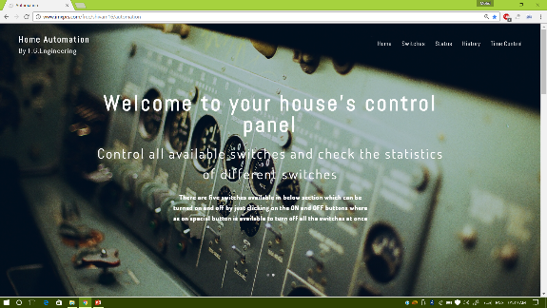
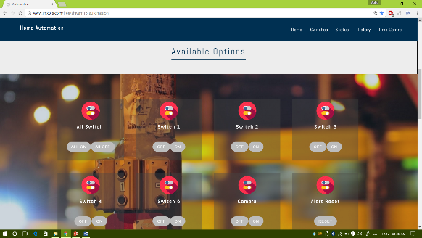
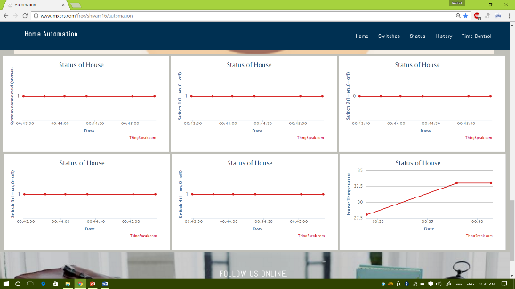
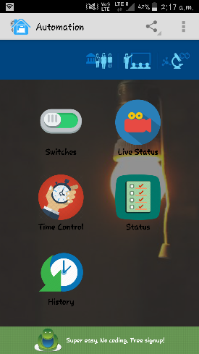
USER INTERFACE AND DESIGN OF GADGET
WEBSITE
ANDROID APP
User can control this system from website as well as from the android app

Slide 11
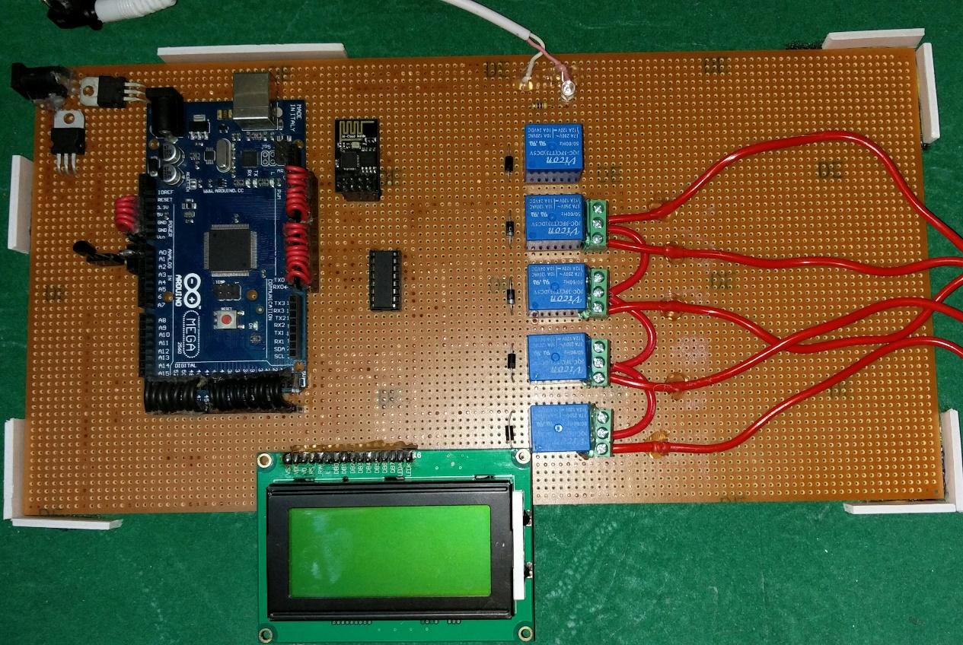
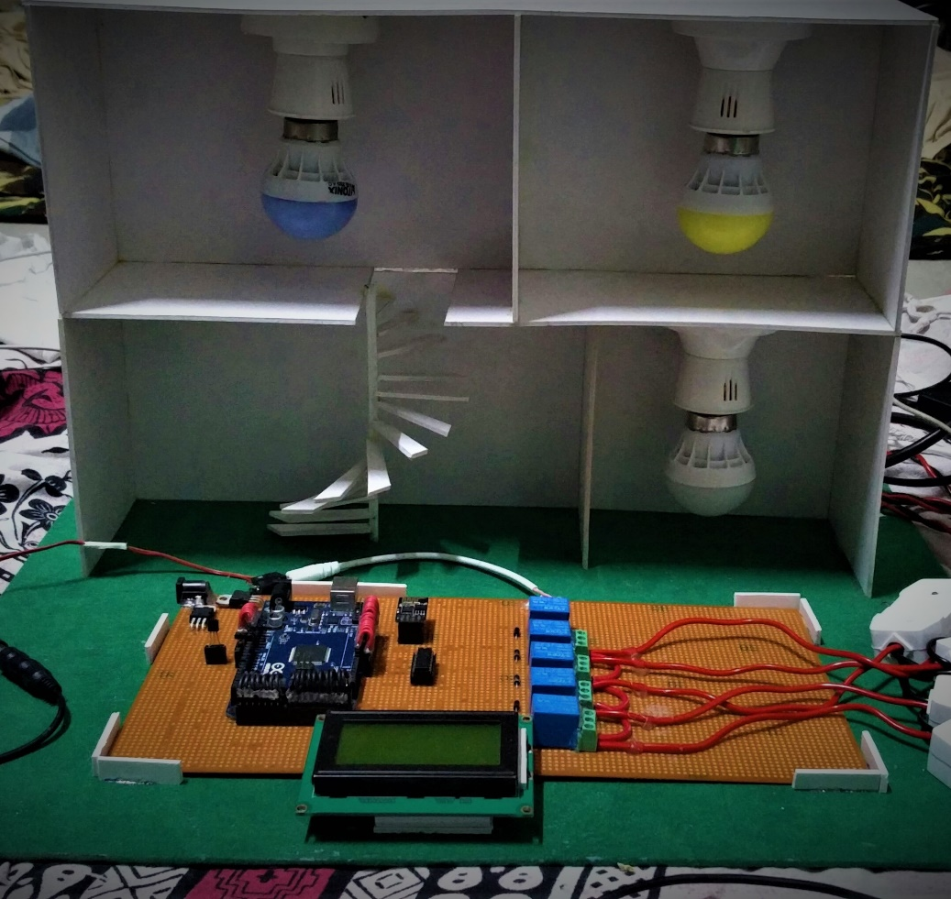
Printed Circuit Board
Working System Prototype

Slide 12
INNOVATION
POWER CONSUMPTION
This system uses very low power, according to our calculations the power consumption in this system is only 5watt.
COMPACTNESS
Our circuit is made on general purpose PCB board and still its very compact. It can even reduce in size when made on professional PCB designing softwares.

Slide 13
THANK YOU

